Slide 1

Markov Model Basics

Slide 2
Basic Markov Terminology

Slide 3
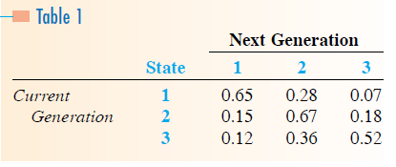

Slide 4
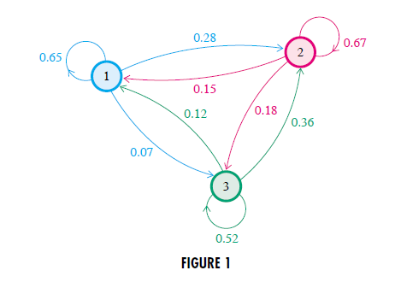

Slide 5
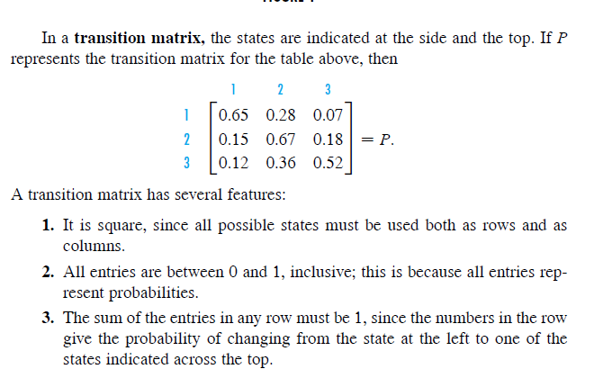

Slide 6
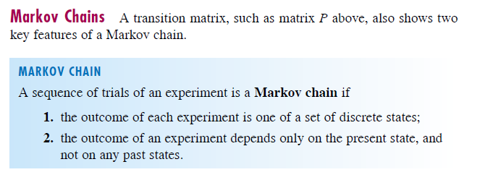

Slide 7
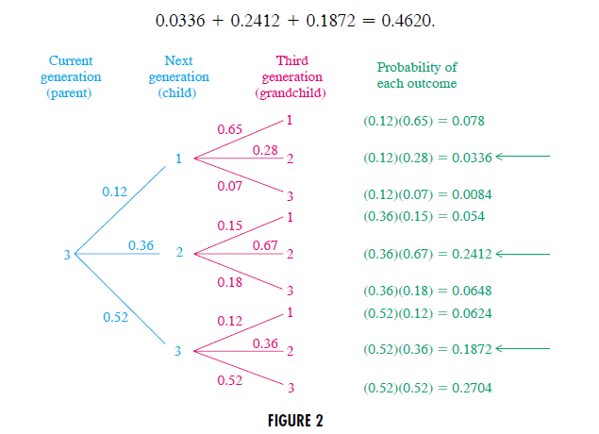

Slide 8
Matrix Multiplication

Slide 9
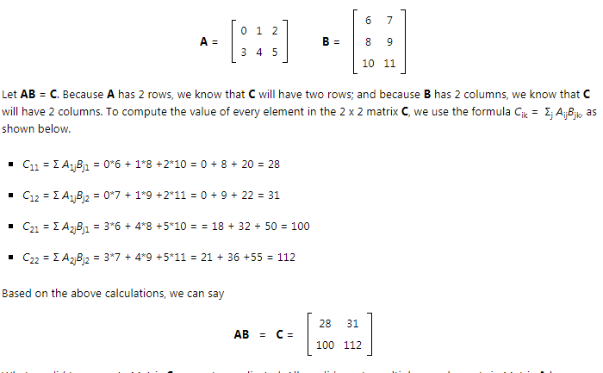

Slide 10
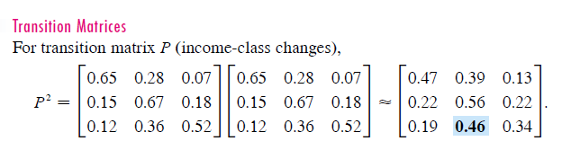

Slide 11
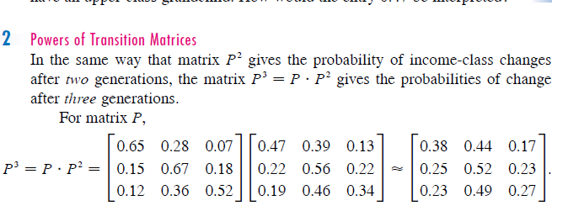

Slide 12
Probability Vectors

Slide 13
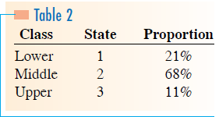


Slide 14


P²

Slide 15
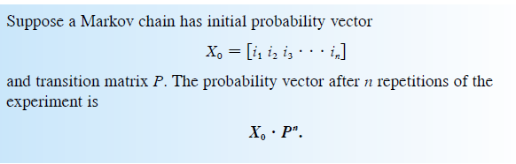

Slide 16
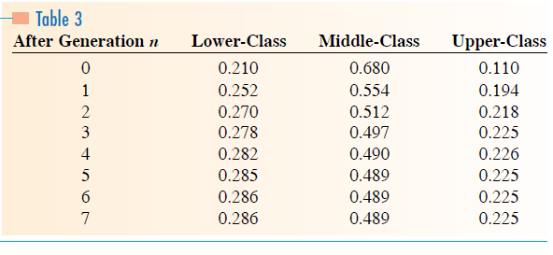
Initial Probability Vector

Slide 17
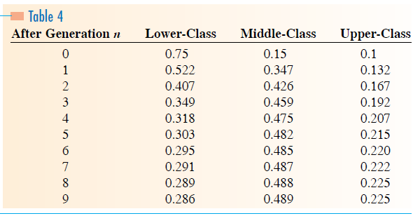
Initial Probability Vector

Slide 18
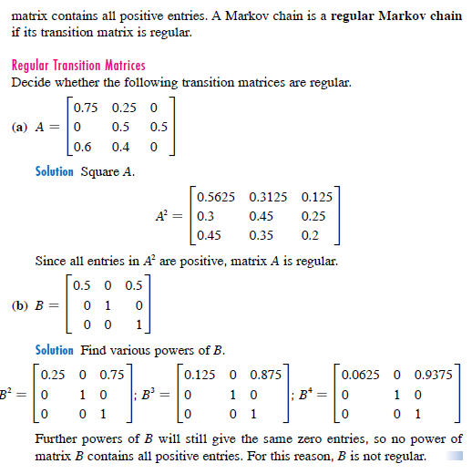

Slide 19
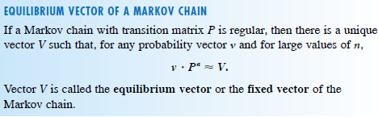

Slide 20
Absorbing States and Absorbing Chains

Slide 21

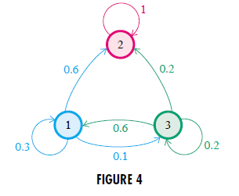
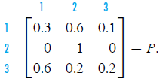

Slide 22
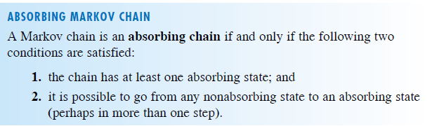

Slide 23
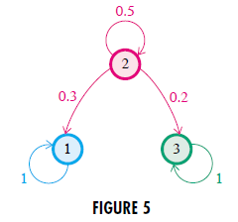
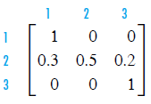
Examples to test if absorbing Markhov Chain

Slide 24
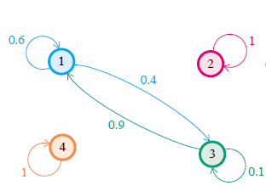
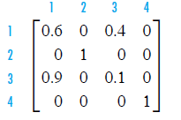
Examples to test if absorbing Markhov Chain

Slide 25
Examples to test if absorbing Markhov Chain

Slide 26
Absorbing Chains and Gallstone Example

Slide 27
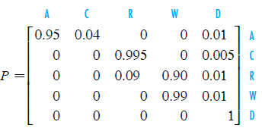
A = Asymptomatic
C = Cholecitis
D = Death
R = Recovery
W = Well
Gallstone Example

Slide 28
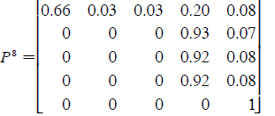
A = Asymptomatic
C = Cholecitis
D = Death
R = Recovery
W = Well
Gallstone Example

Slide 29
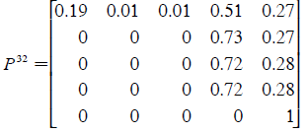
A = Asymptomatic
C = Cholecitis
D = Death
R = Recovery
W = Well
Gallstone Example

Slide 30
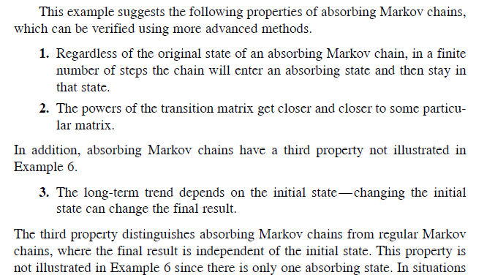

Slide 31
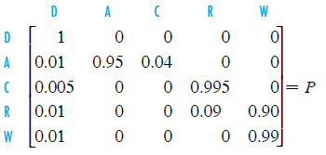
A = Asymptomatic
C = Cholecitis
D = Death
R = Recovery
W = Well
Put the absorbing state in upper left hand corner and reconstruct the rest of the matrix [A C R W]

Slide 32

A = Asymptomatic
C = Cholecitis
D = Death
R = Recovery
W = Well
Put the absorbing state in upper left hand corner and reconstruct the rest of the matrix [A C R W]

Slide 33
A = Asymptomatic
C = Cholecitis
D = Death
R = Recovery
W = Well
Put the absorbing state in upper left hand corner and reconstruct the rest of the matrix [A C R W]

Slide 34
A = Asymptomatic
C = Cholecitis
D = Death
R = Recovery
W = Well
Put the absorbing state in upper left hand corner and reconstruct the rest of the matrix [A C R W]

Slide 35
A = Asymptomatic
C = Cholecitis
D = Death
R = Recovery
W = Well
Put the absorbing state in upper left hand corner and reconstruct the rest of the matrix [A C R W]

Slide 36
A = Asymptomatic
C = Cholecitis
D = Death
R = Recovery
W = Well
Put the absorbing state in upper left hand corner and reconstruct the rest of the matrix [A C R W]

Slide 37

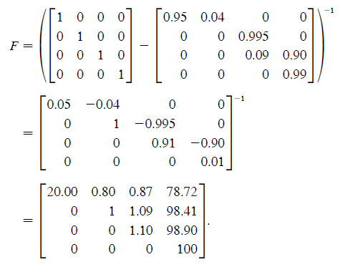
Fundamental Matrix
A = Asymptomatic
C = Cholecitis
D = Death
R = Recovery
W = Well

Slide 38
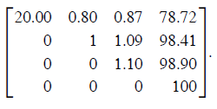
Fundamental Matrix
A = Asymptomatic
C = Cholecitis
D = Death
R = Recovery
W = Well
Average stay in each state
A C R W
A C R W

Slide 39
Fundamental Matrix
A = Asymptomatic
C = Cholecitis
D = Death
R = Recovery
W = Well
Average stay in each state
Each unit is 3 month quarter
So from asymptomatic (A) to death is
20 + .8 + .87 + 78.72 = 100.39 quarters or
(100.39/3 months) = 33.46 years
A C R W
A C R W

Slide 40
A Taste of Hidden Markov Models (HMM)

Slide 41
Hidden Markov Models
Imagine that we are interested in the weather…
And we live in a house with no windows and a roommate who goes out
But we can’t go out and so want to know what the weather is
There are two possible states for the weather: sunny or rainy
Assume that we know the probabilities weather tomorrow given the weather today
1. p(sunny | sunny)
p(sunny | rainy)
p(rainy | rainy)
p(rainy | sunny)

Slide 42
Hidden Markov Models
We can draw the model like this:
Sunny
Rainy
.6
.4
.7
.3

Slide 43
Our transition matrix looks like this:
Tomorrow
Sunny
Rainy
.6 | .4
.3 | .7
Sunny
Today
Rainy

Slide 44
Hidden Markov Models
Imagine that we can observe activities of our roommate and we know what the probabilities are for each activity given the weather
Sunny
Rainy
.6
.4
.7
.3
.1
.5
.4
.6
.3
.1
Walk
Clean
Shop
Walk
Clean
Shop

Slide 45
Hidden Markov Models
Now imagine that we do not know the actual state on
any given day – sunny or rainy
? = hidden
Sunny
Rainy
.6
?
.4
?
.7
.3
.1
.5
.4
.6
.3
.1
Walk
Clean
Shop
Walk
Clean
Shop

Slide 46
Hidden Markov Models
But we can observe what our roommate does each day
Day | 1 | 2 | 3 | 4 | 5 | 6 | 7 | 8 | 9
Action | W | C | S | W | S | S | W | C | W
We can use iterative algorithms to suggest what is the most likely state of the weather on each of those days!

